Slide 1
Cellular Energy

Slide 2
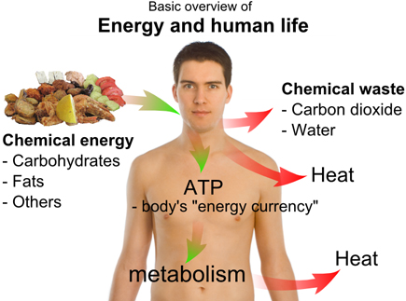
Why do Cells need Energy?
Move
Muscle contraction
Reproduction
Transport molecules
Remove wastes
Chemical reactions
Energy = the ability to do work

Slide 3
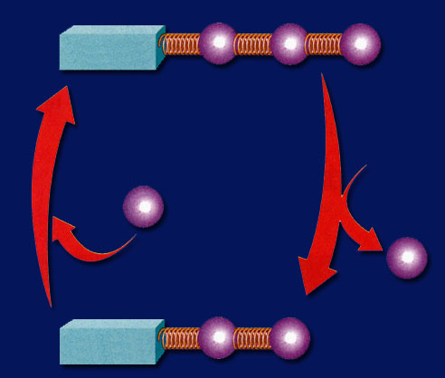
What molecule do cells use for energy?
ATP – Adenosine Triphosphate
Triphosphate tail is unstable and can be broken (releasing energy)
ATP + H₂O → ADP + phosphate + energy
Can be recycled in the cell: ADP + phosphate + energy → ATP
ATP
ADP

Slide 4
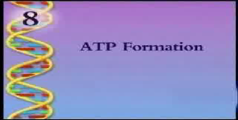
ATP
Click the box to play the movie.

Slide 5
Where do cells get the energy to make ATP?
Cellular respiration is the process that releases energy by breaking down food molecules in small steps.
Converts ADP into ATP
Aerobic Respiration – requires oxygen
Anaerobic Respiration – does not require oxygen (also called fermentation)

Slide 6
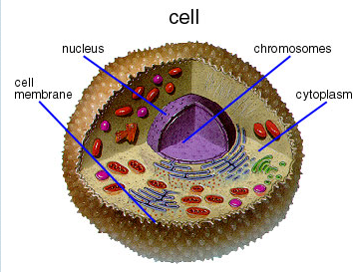
The Cell

Slide 7
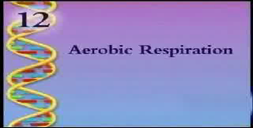
Cellular Respiration

Slide 8
Step 1 - Glycolysis
Glycolysis is the process in which one molecule of glucose is broken in half, producing two molecules of pyruvate.
Happens in the cytoplasm of the cell.
A 6–carbon sugar is broken into 2 3-carbon sugars
Net ATP production is 2

Slide 9
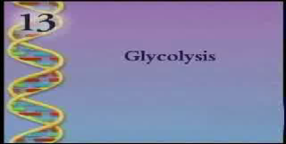
Glycolysis

Slide 10
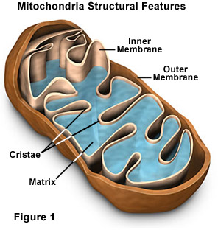
Mitochondria

Slide 11
If no oxygen is present…
The cell goes through fermentation
Alcoholic fermentation is done by yeasts and some microorganisms.
Pyruvate is broken down into alcohol & Carbon Dioxide
Lactic Acid fermentation is done by bacteria and animals.
Pyruvate is converted into lactic acid
In animals - muscles during rapid exercise when the body cannot supply enough oxygen.
Causes muscle cramping and fatigue.

Slide 12
If oxygen is present…
Krebs Cycle
Happens in the matrix of the mitochondria.
Pyruvate is broken down into carbon dioxide in a series of energy-extracting reactions.
Net ATP Production is 2 ATP.

Slide 13
And then…
Electron Transport Chain
Happens in the christae of the mitochondria
The electron transport chain uses the high-energy electrons from the Krebs Cycle to convert ADP to ATP.
Total ATP 32.

Slide 14
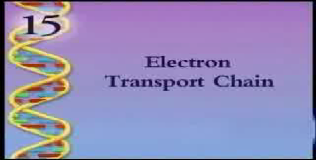
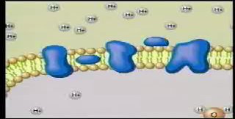
Electron Transport Chain

Slide 15
Totals
Aerobic Respiration
Gycolysis 2 ATP
Krebs Cycle 2 ATP
Electron Transport Chain 32 ATP
Total = 36 ATP
Anaerobic Respiration
Glycolysis 2 ATP
Fermentation 0 ATP
Total = 2 ATP

Slide 16
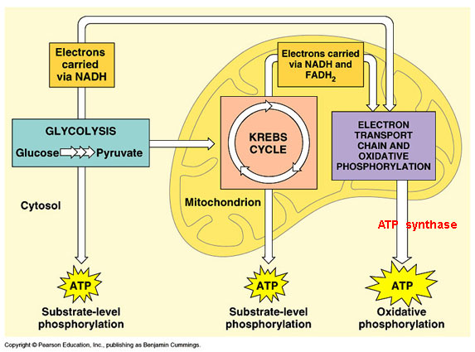
Aerobic Respiration (left side)
2
1
3
2
2
32

